Slide 1
PREFLIGHT BRIEFING COMM AMEL ADD ON

Slide 2
PREFLIGHT BRIEFING – COMM AMEL ADD ON
Typical Test Profile
Preflight Inspection – Please immediately call for Fuel – Oil – Windscreen Clean - Deiced
Take Off and Climb out – Short Field Take Off, scenario with 50’ obstacle. PIC calls “clear”.
Advise ATC which practice area.
Upper Airwork Maneuvers
Simulated Emergencies
Simulated Single Engine Inoperative Instrument Approach
Approaches, Landings and Go-Around
Note: You may start with landings at departure airport first.
Post Flight

Slide 3
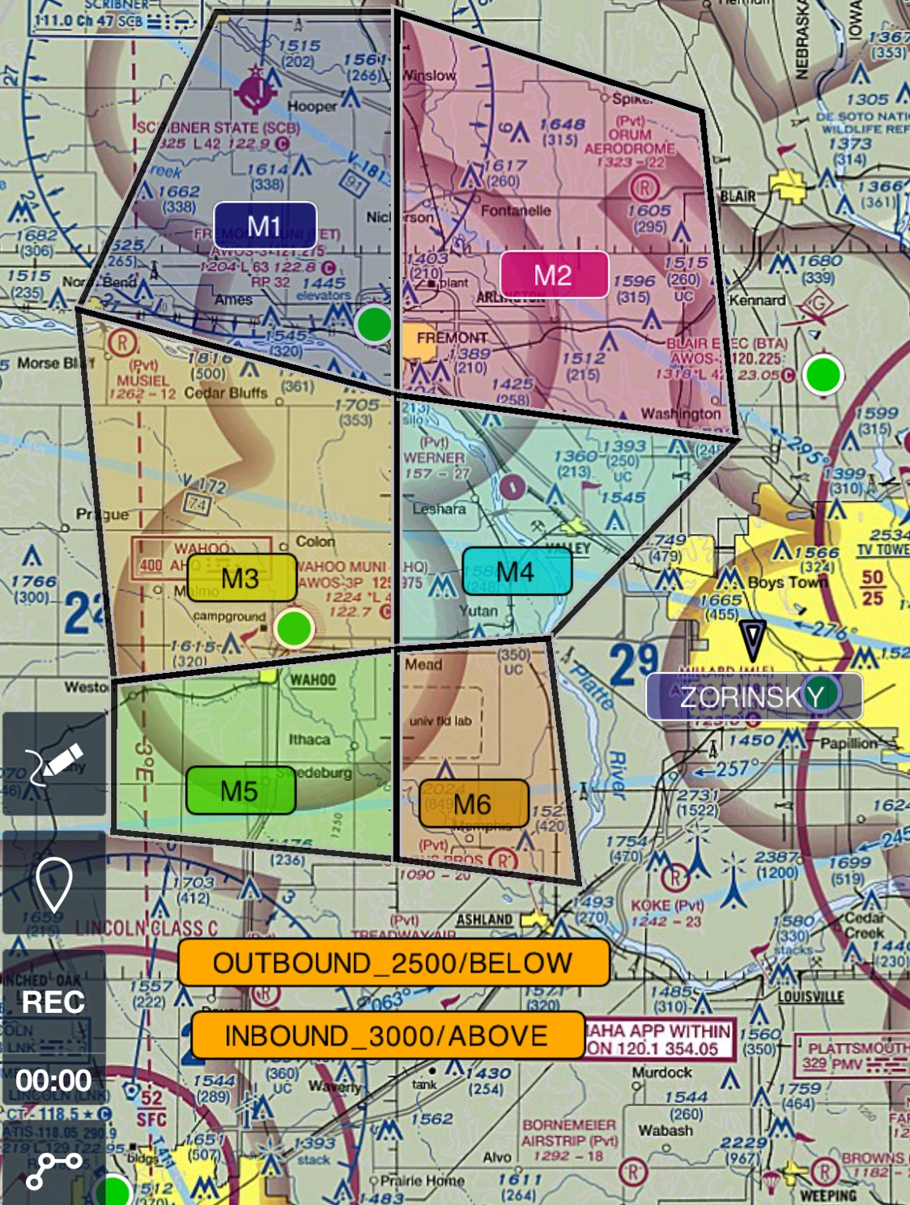
Practice Area and Airspace Avoidance is Applicant Responsibility
PREFLIGHT BRIEFING – COMM AMEL ADD ON

Slide 4
PREFLIGHT BRIEFING – COMM AMEL ADD ON
Examiner Rules of Conduct
Applicant is the PIC (61.47) and makes the Go/No-Go Decision with no external pressure created by Examiner.
Oral questioning will continue into the flight portion.
I am considered a non-pilot passenger for the scenario.
Exchange of Flight Controls – FAA 3 step process.
Applicant responsible for all ATC Communications.
Avoid Examiner intervention with missed calls.
PHX - Examiner responsible for CTAF communication in the “Stack”.
Visual Clearing Turns mandatory before the start of maneuvers, but may not always be required if previous maneuver cleared the area.
Emergency Descents – always clear the area, Terrain/Obstacles/Traffic/ before executing and advise CTAF or ATC. Examiner will assign recovery altitude.

Slide 5
PREFLIGHT BRIEFING – COMM AMEL ADD ON
SINGLE ENGINE INOP SIMULATED INSTRUMENT APPROACH AND LANDING
Landing airport scenario weather: Visibility and Ceiling simulated at published IAP minimums.
Applicant must verbally call out “minimums” when reaching DA or MDA and Examiner will say “Runway Insight”.
Unstabilized flight from DA or MDA to touchdown does not meet ACS standards.
Stabilized flight must transition from electronic GS or GP to the PAPI or VASI if available.

Slide 6
PREFLIGHT BRIEFING – COMM AMEL ADD ON
AMEL – 4 Failures Scenarios:
Rejected Takeoff
– simulated no faster than 50% of calculated VMC speed
Engine Failure After Lift Off
– simulated using throttle only, until attaining at least VSSE/VXSE/VYSE and no lower than 400’ AGL.
Engine Failure at Cruise
– intentional SE Ops no lower than 3000’ AGL ACS and no lower than 4000’ AGL POH – PA34/44 pg 4-40
Approach and Landing with an Inoperative Engine (Simulated) (solely by Reference to Instruments)
– simulated using throttle Idle only, before reaching the FAF.

Slide 7
PREFLIGHT BRIEFING – COMM AMEL ADD ON
AMEL STALLS:
Accelerated Stall – Recover at First Wing Stall Indication
Power On Stall Entry: approx. 65%/20hg, Max Pitch 20 deg., Recovery at First Wing Stall Indication
Power Off Stall Recovery after First Wing Stall Indication
VMC Demo - I will not block the rudder inflight.

Slide 8
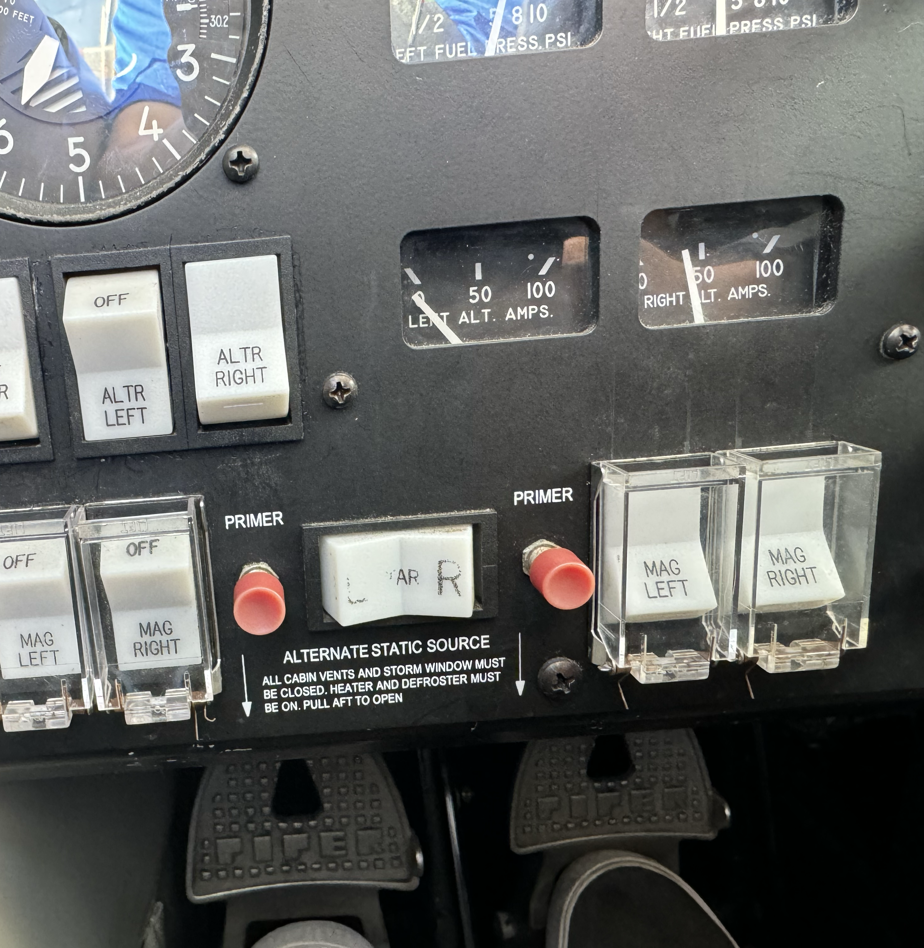
PREFLIGHT BRIEFING – COMM AMEL ADD ON
Severe Damage Scenario at Cruise
Intentional SE Ops no lower than 4000’ AGL POH – PA34/44 (no lower than 3000’ AGL ACS)
Secure Checklist procedures will be expected to be completed as shown in pictures below.
All other Engine controls selected Off with securing engine procedures.
Fuel Selectors Not to Be Shut Off Inflight – Sufficient to touch for simulation.

Slide 9
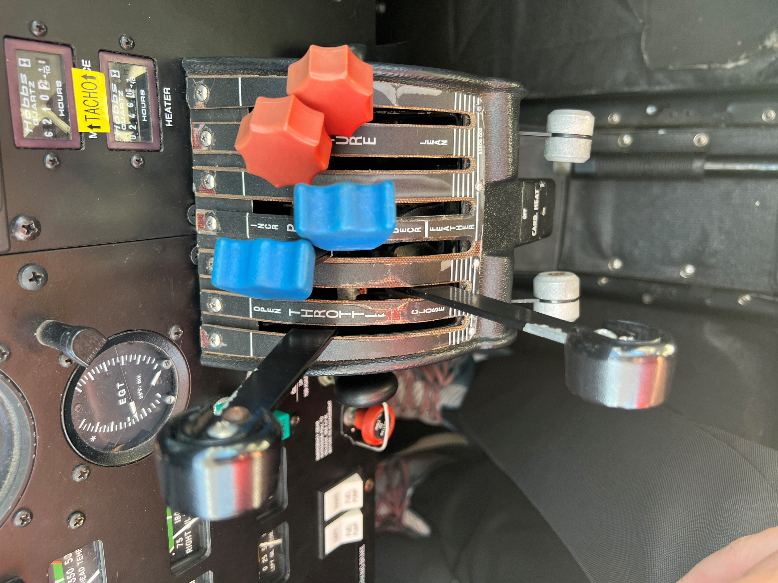
Low Altitude Engine Failure Scenarios:
Engine Failure After Lift Off
and
Simulated SE Inoperative
Instrument Approach
Simulate feathering by moving prop control approximately one inch towards feather position.
Simulate securing engine by moving mixture approximately one inch towards lean position.
Evaluator will simulate Zero Thrust.

Slide 10
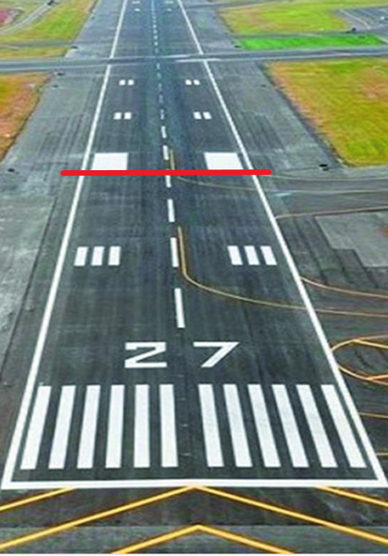
PREFLIGHT BRIEFING – COMM AMEL ADD ON
VFR APPROACHES AND LANDINGS
Each type of landing and touchdown area must be determined verbally no later than downwind.
Discuss type of landings: touch-n-goes, stop-n-go, or full stop.
Assume a 50’ obstacle at the end of runway for the Short Field Landing.
Go arounds are okay with all approaches, except Single Engine.
They must not be used excessively or performed incorrectly.
If I verbalize, “Scenario: Aircraft departing in front of us.”
Play the scenario and perform Go-Around with Side Step.
Typical landing area starts at the white
1000’ marker.
0’
0’

Slide 11
PREFLIGHT BRIEFING – COMM AMEL ADD ON
IF ACTUAL EMERGENCY OCCURS AT ANYTIME INFLIGHT – “MAYDAY”, “MAYDAY”, “MAYDAY”
Test is immediately over and we will work as a team to land safely.
Applicant will maintain on the flight controls unless a positive exchange is required for the safe outcome.
Gear Up Threat discuss.
If examiner calls “Go-Around, Gear” or Civilian Tower calls “Check Gear Down”, then it will be considered a failure.

Slide 12
PREFLIGHT BRIEFING – COMM AMEL ADD ON
Please immediately call for Fuel – Oil – Windscreen Clean - Deiced
Preflight start time. Short break and meet at the aircraft.
Please start preflight without me if necessary, I will be at the aircraft soon.
My Cell Phone - 713 703-8478
Please text me if anything changes.

Slide 13
Questions?

Slide 14
LETS FLY!

